Slide 1
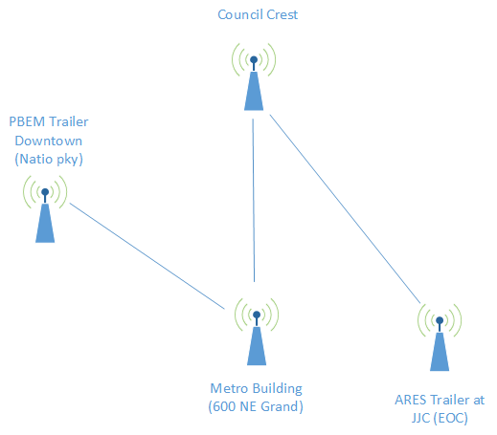
Multnomah County ARES
March 2016
MultnomahARES.org Leadership@multnomahARES.org

Slide 2
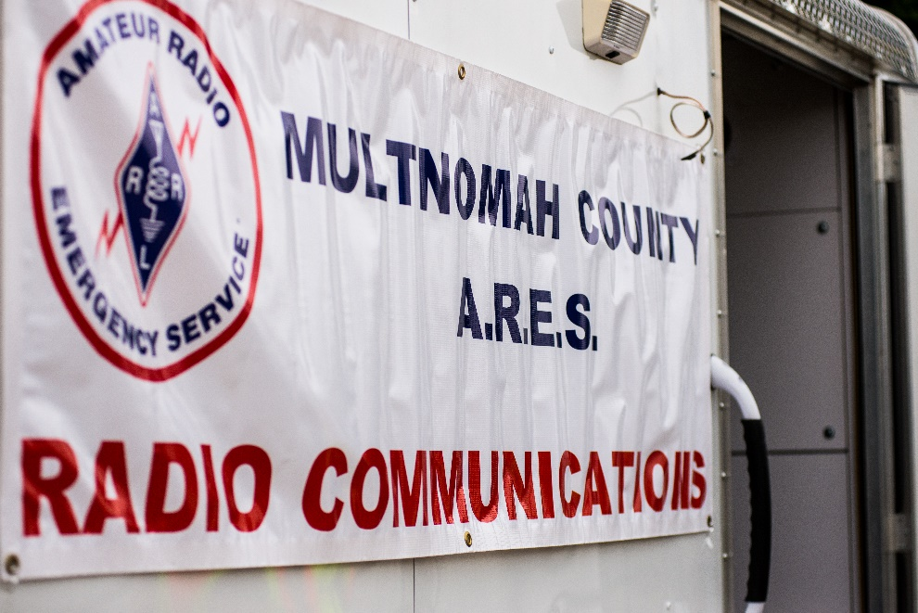
Welcome to the ARRL field unit for Multnomah County!
First Meeting? Please introduce yourself!
Please sign the attendance sheet.
Photo: Robert Anglin

Slide 3
Leadership Team
Emergency Coordinator: Nathan Hersey N9VCU
Assistant EC: Adam Karol KF7LJH
Assistant EC: Robert Anglin WX5TEX
Assistant EC: Deb Provo KK7DEB
Training Manager: Steve Konrad AF7DD
Net Manager: Marino Duregon KG7EMV
Web Master: Brian Cochrane KE7QPV
PIO: Steve Hall W7RSH
Photo: Robert Anglin

Slide 4
Team Leaders
Multnomah County ECC: Deb Provo KK7DEB
Portland Bureau of Emergency Management: Brian Cochrane KE7QPV
City of Gresham and East County: Robert Anglin WX5TEX
Red Cross: John Beaston K7TY
Oregon Food Bank: Kiri Hargie K7KAH
Lewis and Clark College: Julie Couch W7OW
Rover: Michael Schilmoeller AE7XP
Field Net Control – Adam Karol KF7LJH
West Side Field Relay Team – Steve Hall W7SRH

Slide 5
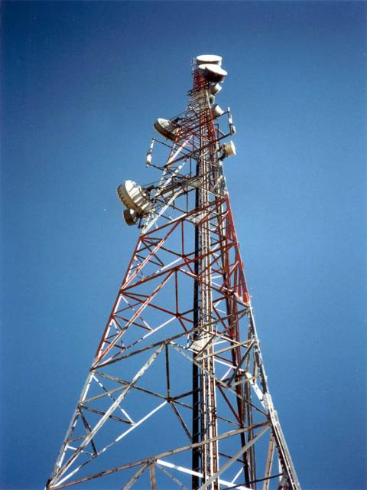
Agenda
Leadership Updates
Events Completed
Events Upcoming
Training

Slide 6
Regular Meetings and Nets
PARC: Fourth Friday of the Month, 7:30pm at Liberty Centre Building (W7LT.org)
HVARC: Third Thursday of the Month, 7:30pm MHCC Rm 1001 (WB7QIW.org) –
ARES net: Wednesdays 7:00pm on 146.840
Sign Up and Do It!
NWTTN: Nightly at 6:05pm on WORC repeaters.
Neighborhood Emerg. Comms Training net (NECTN): 8:00pm on ARRG Linked system
Now the largest net on the ARRG system – Go Michael!

Slide 7
Leadership updates
Contact Leadership
Leadership@multnomahares.org
Trailer
Recruiting Update
Cascadia Rising
Digital Radio – it’s decision time
Portland Public Schools

Slide 8
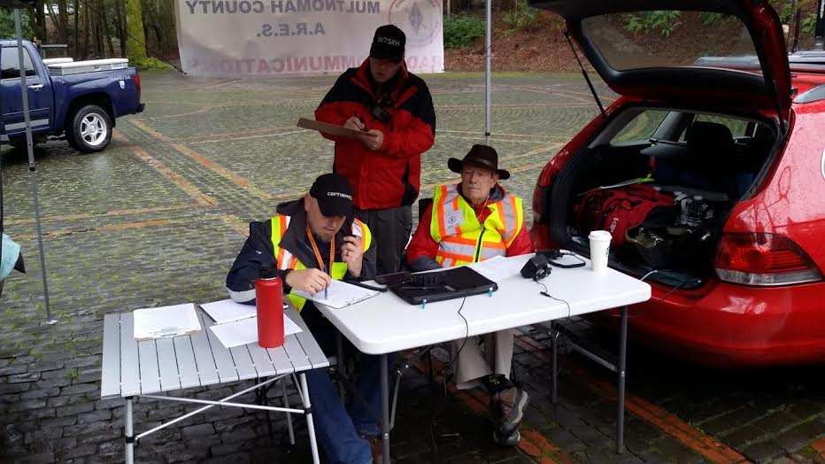
Events Completed
BEECN Exercise

Slide 9
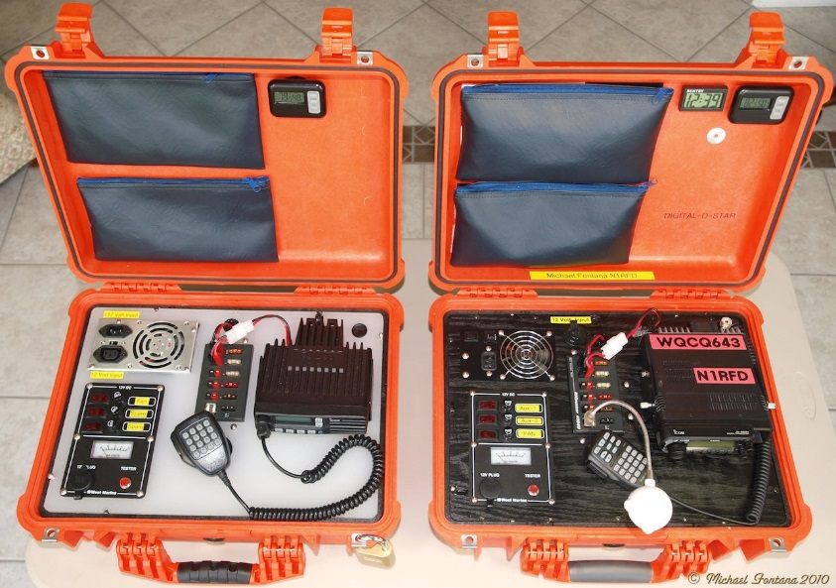
Events/Training Upcoming
Spring Set/ MS Walk Pre-Brief 4-21@1900
PFB 2 Training TAC Room 2
Spring SET and MS Walk
April 22nd and 23rd
Cascadia Rising
June 8th and 9th

Slide 10
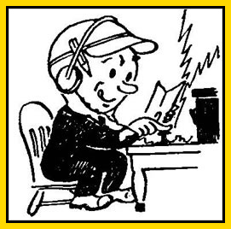
Any other announcements ?

